Slide 1

INTERNSHIP PROJECT REVIEW
HDI PREDICTION AND
ANALYTICS SYSTEM
HDI Intelligence
A Comprehensive Measure of Well-Being
PRESENTED BY
PROJECT GUIDE
Madireddy Meena Mahanth Harinadh
Dr. Battina Srinuvasu Kumar
M.Tech., Ph.D. postdoc(SIT)
23481A5498
Professor & Mentor
Seshadri Rao Gudlavalleru Engineering College
B.Tech — Artificial Intelligence and Data Science Academic year 2026–2027
AI & Machine Learning Virtual Internship
SmartBridge Educational Services Pvt. Ltd. with APSCHE
Two months, 120 hours
HDI Intelligence
INTERNSHIP REVIEW / 30 OCTOBER 2026
01
Notes:
Speaking time: about 30 seconds.
Good morning. I am Madireddy Meena Mahanth Harinadh, roll number 23481A5498. My project is the HDI Prediction and Analytics System, branded HDI Intelligence. I developed it during the Artificial Intelligence and Machine Learning virtual internship with SmartBridge and APSCHE, under the guidance of Dr. Battina Srinuvasu Kumar. I will cover the problem, approach, technology choices, current progress and remaining work.
Sources: 7. Project Documentation/Academic_Documentation.docx and Academic_Documentation.pdf; supplied faculty circular and student details.

Slide 2
PROBLEM & OBJECTIVES
Problem statement
01
Scattered datasets
Beginners must navigate large country tables.
ONE UNDERSTANDABLE
PLATFORM
02
Manual comparison
Country and year comparisons take extra work.
Explore published data
Estimate HDI transparently
Compare scenarios
03
Opaque calculations
An index value can hide how it was calculated.
04
Static reports
Readers cannot test hypothetical inputs.
Estimates use same-year indicators.
Future forecasting is outside the scope.
HDI Intelligence
INTERNSHIP REVIEW / 30 OCTOBER 2026
02
Notes:
Speaking time: about 35 seconds.
The problem is accessibility. Published UNDP tables contain useful information, but a beginner must move between datasets, definitions and calculation tools. Comparing countries across years takes manual work, and static reports cannot show what happens when an input changes. My solution brings exploration and calculations into one understandable platform. The scope is same-year HDI estimation and hypothetical comparison, rather than predicting a country’s future.
Sources: README.md; Academic_Documentation.docx, problem statement and project scope.

Slide 3
PROBLEM & OBJECTIVES
Project objectives
01
02
03
Explore
Estimate
Compare
Published UNDP country data
HDI using a trained ML model
Historical development indicators
04
05
Analyze scenarios
Explain transparently
Hypothetical changes in inputs
Formula, metrics and optional AI
HDI Intelligence
INTERNSHIP REVIEW / 30 OCTOBER 2026
03
Notes:
Speaking time: about 35 seconds.
The project has five objectives. First, make published UNDP data easy to explore. Second, estimate HDI using the trained regression model. Third, compare historical indicators across countries. Fourth, let users change socioeconomic inputs and inspect a hypothetical scenario. Finally, keep the outputs transparent through the formula, evaluation metrics and optional AI explanations. The numerical features remain usable even when no AI key is configured.
Sources: README.md, Key Features; src/pages/Explorer.tsx, Predictor.tsx, Scenarios.tsx and EvaluationView.tsx.

Slide 4
METHODOLOGY / APPROACH
Methodology and system approach
1
2
3
4
5
UNDP dataset
Data cleaning
Feature preparation
Country split
Model comparison
HDR 2025 snapshot
Complete observations
Natural log of income
Train / validation / test
Minimum validation MAE
6
7
8
9
Linear Regression
Model export
React application
HDI results
Refit on development data
Coefficients in JSON
Shared JavaScript inference
Predictions and visualizations
OPTIONAL AI BRANCH
Vercel function
Groq API
AI explanation
Numerical prediction works
in the browser without Groq.
Personal key, only for an explanation request
HDI Intelligence
INTERNSHIP REVIEW / 30 OCTOBER 2026
04
Notes:
Speaking time: about 55 seconds.
The workflow begins with the UNDP snapshot. Python keeps complete country observations and prepares four features, using the natural logarithm of income. Countries are separated across training, validation and testing. I compare four regressors and select Linear Regression using validation error. After refitting on the development data, I export its parameters as JSON. The React application evaluates that model through shared JavaScript. A separate optional path sends an explanation request through a Vercel-compatible serverless function to Groq. This path needs a personal API key. It does not calculate or replace the browser’s HDI prediction.
Sources: 8. Project Demonstration/public/data/evaluation.json; public/data/model.json; shared/inference.mjs; 7. Project Documentation/MODEL_CARD.md. ml/train.py; api/insights.mjs; src/AIContext.tsx. Vercel is the configured hosting target, not a verified live deployment.

Slide 5
METHODOLOGY / APPROACH
Dataset and preprocessing
193
5,940
1990–2023
Countries and territories
Complete country-year records
Observation years
SOURCE UNDP Human Development Report 2025
FOUR MODEL INPUTS
Life expectancy
Expected schooling
Mean schooling
GNI per capita
Years
Years
Years
Constant 2021 PPP dollars
Complete cases
Log income
Country-separated splits
622 incomplete rows excluded
ln(GNI), other inputs unchanged
3,611 train / 1,178 validation / 1,151 test
HDI Intelligence
INTERNSHIP REVIEW / 30 OCTOBER 2026
05
Notes:
Speaking time: about 40 seconds.
The prepared snapshot contains 5,940 complete observations for 193 countries and territories from 1990 to 2023. The four inputs are life expectancy, expected schooling, mean schooling and GNI per capita in constant 2021 purchasing-power-parity dollars. We exclude 622 incomplete country-year records rather than inventing missing values. Income receives a natural-log transform. Splitting by country prevents the same country appearing in both development and test partitions. The final test set contains 1,151 rows from 39 unseen countries.
Sources: 8. Project Demonstration/public/data/evaluation.json; public/data/model.json; shared/inference.mjs; 7. Project Documentation/MODEL_CARD.md.

Slide 6
METHODOLOGY / APPROACH
HDI formulas and the ML estimate
OFFICIAL DIMENSION INDICES
DIRECT HDI CALCULATION
Health
Iₕ = (LE − 20) / 65
Geometric mean
Life expectancy: 20–85 years
HDI = ∛(Iₕ × Iₑ × Iᵢ)
Education
Iₑ = ½ × (MYS / 15 + EYS / 18)
Mean schooling: 0–15 Expected: 0–18
Normalize the components to [0, 1].
The app caps indices at these bounds.
Income
Iᵢ = ln(GNI / 100) / ln(75000 / 100)
GNI per capita: 100–75,000 (2021 PPP $)
TRAINED LINEAR REGRESSION
ŷ = β₀ + β₁LE + β₂EYS + β₃MYS + β₄ln(GNI)
LE: life expectancy EYS: expected schooling MYS: mean schooling GNI: income per person
HDI Intelligence
INTERNSHIP REVIEW / 30 OCTOBER 2026
06
Notes:
Speaking time: about 50 seconds.
The official HDI calculation normalizes health, education and income using fixed goalposts, then takes the geometric mean. Education averages the two schooling indices, while income uses a natural logarithm. The app bounds its component indices between zero and one. The equation at the bottom is a different operation: a fitted linear model using the same indicators and log income. Its coefficients come from training, and the final prediction is clipped to zero to one. The official formula gives the direct calculation. The model supports an educational comparison of regression methods, so the website shows both results separately.
Sources: UNDP HDR 2025 Technical Note 1: https://hdr.undp.org/sites/default/files/2025_HDR/hdr2025_technical_notes.pdf ; shared/inference.mjs, formulaHDI and predict functions; model.json.

Slide 7
METHODOLOGY / APPROACH
Model selection and recorded results
0.004404
0.006670
0.998183
MAE
RMSE
R²
Average absolute error
Emphasizes larger errors
Goodness of fit
VALIDATION MAE / LOWER IS BETTER
Why Linear Regression?
Lowest validation MAE
0.004148
Narrowly ahead of Extra Trees
0.004209
R² is not percentage accuracy.
Held-out countries. Same-year reconstruction. The official formula remains the direct method.
HDI Intelligence
INTERNSHIP REVIEW / 30 OCTOBER 2026
07
Notes:
Speaking time: about 65 seconds.
I compared Linear Regression, Decision Tree, Random Forest and Extra Trees. The chart shows validation MAE, where smaller is better. Linear Regression achieved about 0.004148, narrowly ahead of Extra Trees at 0.004209, so I selected it using the predefined rule. After refitting, its test MAE was 0.004404, RMSE 0.006670 and R-squared 0.998183. MAE describes average absolute error, RMSE emphasizes larger differences, and R-squared describes fit rather than percentage accuracy. These are same-year reconstruction results. Because HDI is defined from these components, the direct formula remains the proper direct calculation. The ML work demonstrates model comparison, export and transparent educational analytics.
Sources: 8. Project Demonstration/public/data/evaluation.json; public/data/model.json; shared/inference.mjs; 7. Project Documentation/MODEL_CARD.md. Metric cards use test, chart uses comparison (validation). All values rounded to six decimals only for display.

Slide 8
TOOLS & TECHNOLOGIES
Tools and technologies
IMPLEMENTED LOCALLY
TOOLS PLANNED / USED
Frontend
React 19, TypeScript, Vite 7, Tailwind CSS
Visualization
Recharts and Lucide Icons
Machine learning
Python, Pandas, NumPy, scikit-learn
AI integration
Groq API through a serverless endpoint
Development
Visual Studio Code, Git and GitHub workflow
Deployment target
Vercel, Node.js 24.x
Groq integration is implemented. Production deployment and live-provider checks remain pending.
HDI Intelligence
INTERNSHIP REVIEW / 30 OCTOBER 2026
08
Notes:
Speaking time: about 30 seconds.
The frontend uses React 19 and TypeScript with Vite and Tailwind. Recharts draws the data visualizations, and Lucide provides interface icons. Python, Pandas, NumPy and scikit-learn support data preparation and training. The selected Linear Regression model runs as exported JavaScript inference in the browser. Groq is optional and is accessed through a serverless endpoint. VS Code is the development environment, with Git and GitHub for the publication workflow. Vercel is the deployment target, and its hosted workflow still needs verification.
Sources: 8. Project Demonstration/package.json, package-lock.json, ml/requirements.txt and api/insights.mjs; README.md.

Slide 9
PROGRESS & NEXT STEPS
Current project progress
Dataset prepared
Model trained and evaluated
COMPLETED
COMPLETED
React frontend developed
Interactive HDI Predictor
COMPLETED
COMPLETED
Country data explorer
Historical charts
COMPLETED
COMPLETED
Scenario analysis
Personal Groq key controls
COMPLETED
VERIFIED LOCALLY
Technical and academic documents
Local testing and production build
COMPLETED
VERIFIED LOCALLY
Recorded on 28 Oct 2026: 22 Node tests, 11 browser tests, 1 production check and build passed
HDI Intelligence
INTERNSHIP REVIEW / 30 OCTOBER 2026
09
Notes:
Speaking time: about 35 seconds.
The main development work is complete locally. This includes the dataset, evaluated model, React interface, predictor, country explorer, historical charts, scenario analysis and personal-key controls. Technical and academic documentation are also prepared. The final verification record dated 28 October reports 22 Node tests, 11 browser tests, one production browser check and a successful build. These are recorded local results. I still need to confirm the public deployment and a genuine Groq request on the hosted site.
Sources: 6. Project Testing/verification.json (final cleanup record takes precedence over earlier report-evidence.json test count); src/pages; src/AIContext.tsx; 7. Project Documentation.

Slide 10

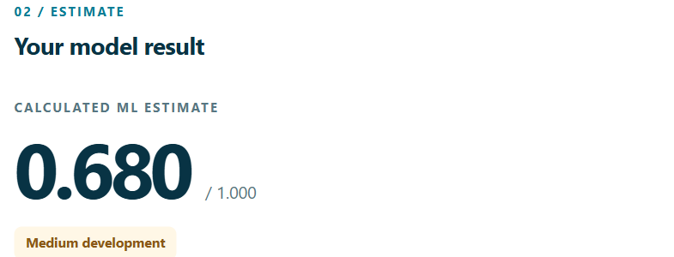
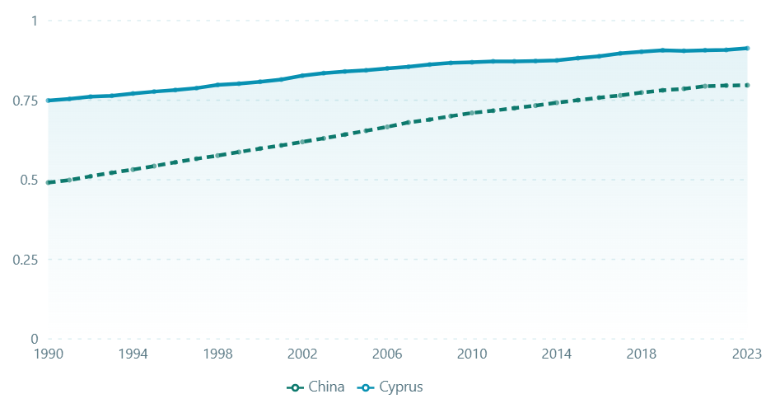
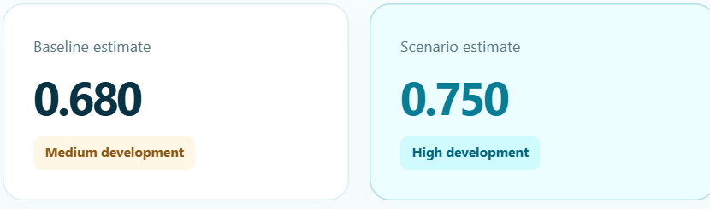
PROGRESS & NEXT STEPS
Application demonstration
Home
HDI Predictor
Explore Data: Cyprus and China
Scenario Analysis
Change: +0.0692 HDI points
HDI Intelligence
INTERNSHIP REVIEW / 30 OCTOBER 2026
10
Notes:
Speaking time: about 40 seconds.
These are genuine captures of the cyan website, cropped to highlight the main outputs. Home introduces the index. Explore Data shows a working historical comparison for Cyprus and China. The predictor displays an India preset estimate of 0.680, and the scenario changes life expectancy to 78 and mean schooling to 10, producing about 0.750 and a change of 0.0692. If time permits, switch to the live local website at http://127.0.0.1:5173 here. Open Explore Data, then Predictor, then Scenarios. Explain that a scenario shows the model response to inputs, not a causal policy effect.
Sources: Actual retained local captures, 28 October 2026: 6. Project Testing/home.png, trend-detail.png (Explore Data), predictor.png and scenarios.png. Screenshot states and inputs: report-evidence.json. No AI-generated screens or AI responses.

Slide 11
PROGRESS & NEXT STEPS
Next steps
Development completed locally
PUBLICATION AND HOSTING REMAIN
01
Publish the cleaned project
Push the current version to the existing GitHub repository.
02
Deploy HDI Intelligence
Create or confirm the Vercel project: hdi-intelligence.
03
Configure production
Set APP_ORIGIN and the required environment configuration.
04
Verify the hosted workflow
Check routes, charts, predictions and a genuine Groq request.
05
Complete faculty review
Collect feedback and make the final improvements.
HDI Intelligence
INTERNSHIP REVIEW / 30 OCTOBER 2026
11
Notes:
Speaking time: about 30 seconds.
The remaining work is publication and production verification. First, I will push the cleaned current version to the existing GitHub repository. Then I will deploy or confirm the Vercel project, configure the exact production origin and environment settings, and test the hosted workflow. A successful local AI settings test does not establish a successful provider request, so that needs a genuine hosted check. Finally, I will incorporate faculty feedback. I have not assigned unsupported completion percentages or deadlines.
Sources: README.md, deployment instructions; verification.json limitations. Academic_Documentation.docx now states a deployment URL, but a read-only check on 29 October 2026 could not resolve hdi-intelligence.vercel.app. Its live status remains unconfirmed.

Slide 12

CONCLUSION
Thank You
Real UNDP data exploration
Transparent ML-based HDI estimation
Interactive visualization and optional AI explanations
♥
Created by Madireddy Meena Mahanth Harinadh
GitHub
github.com/meenamahanth/HDI-Prediction-Analytics-System
UNDP Data
hdr.undp.org/data-center/documentation-and-downloads
Vercel target
https://hdi-intelligence.vercel.app/
HDI Intelligence
INTERNSHIP REVIEW / 30 OCTOBER 2026
12
Notes:
Speaking time: about 20 seconds.
To conclude, HDI Intelligence makes real UNDP data easier to explore and connects it with transparent model estimates and interactive scenarios. Optional AI explanations support the numerical results. The GitHub repository and official UNDP data links are available here. Vercel remains the deployment target until the live workflow is confirmed. Thank you. I welcome your questions.
Sources: README.md; evaluation.json; supplied GitHub and UNDP links. No speculative live deployment link included.

